Slide 1

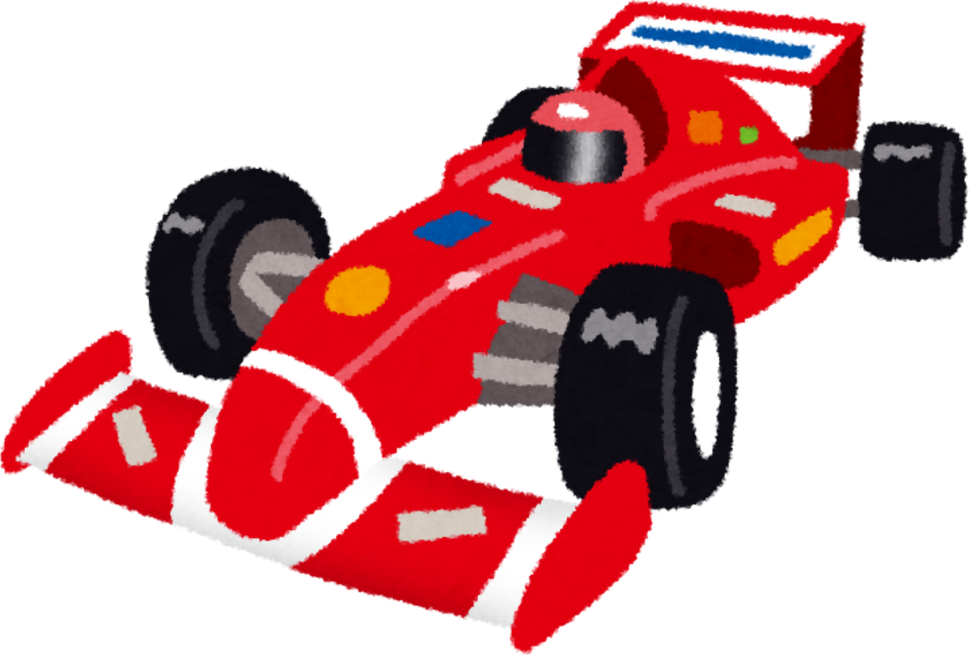
Optimizing Strategic Decisions in Formula One Q3 Qualifying
Uma Bhat, Asher Cohn, Sawyer Fotheringham, Philip Garside, Rhett Lavender, Abisai Lujan

Slide 2
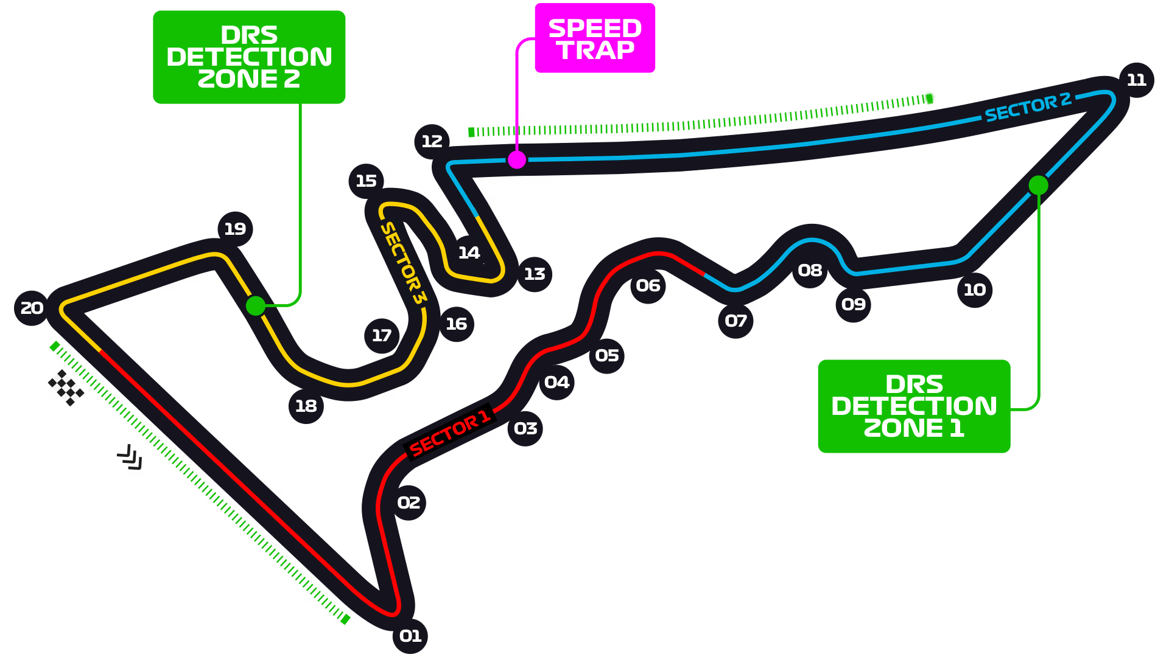
INTRODUCTION
Formula 1: Premier single-seater
int’l motorsport
main event: grand prix points
[secret to success]: start towards
THE FRONT OF THE LINE
focus: Qualifying Q3, the final round
to success
goal: identify strategic decisions in q3 INFLUENCING STARTING POSITION FOR GRAND PRIX
approach: collect observational data from Q3 replays in f1 2024 archive
Notes:
[secret to success]: start AT THE FRONT OF THE LINE

Slide 3
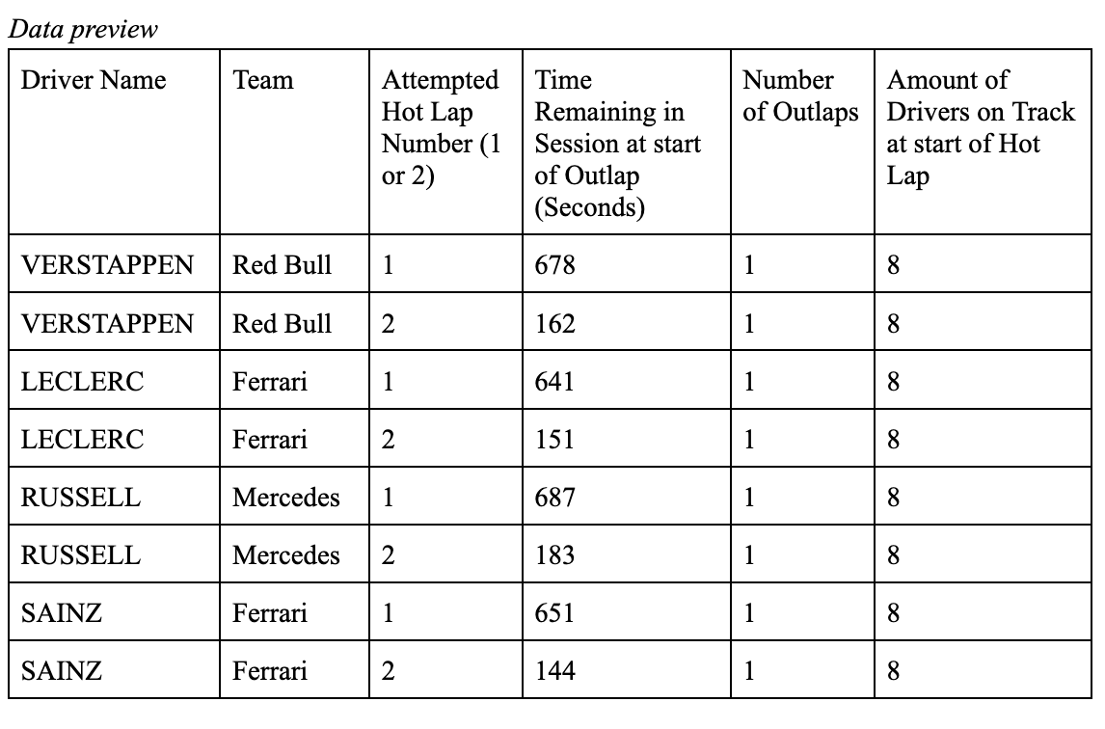
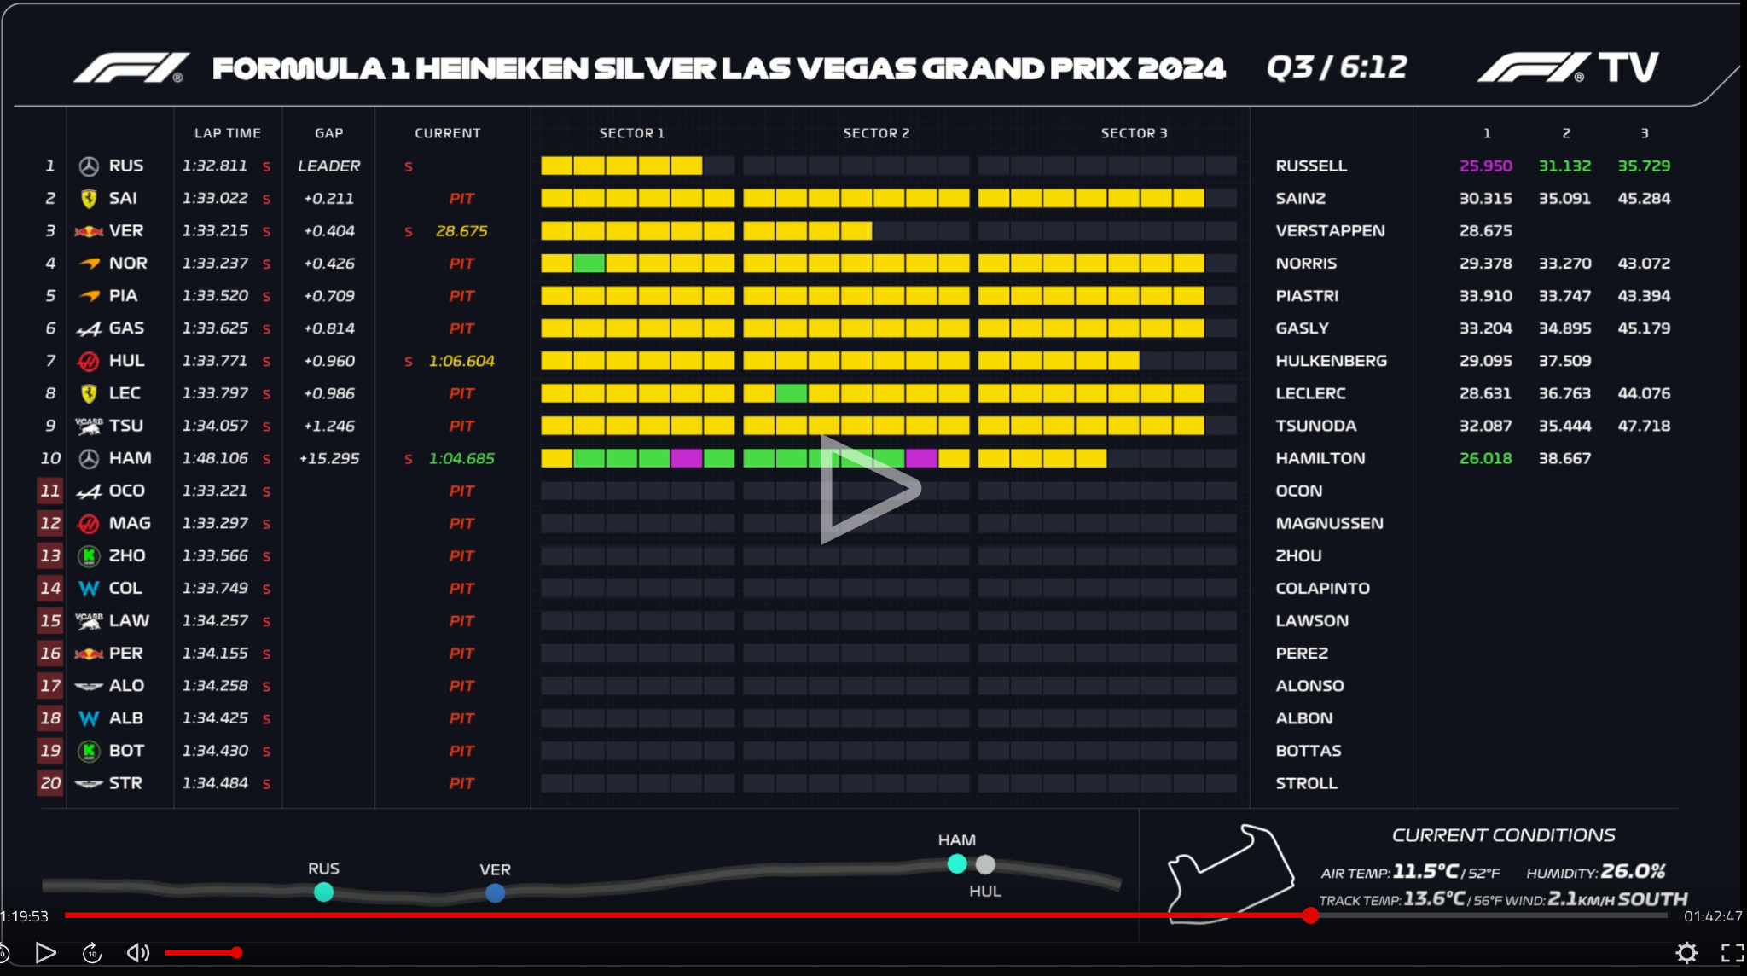
summary of The data
> data spanning q3 qualifying sessions from the 2024 season, acquired using f1 tv
> we used the data panel of each qualifying stream to identify who was on the track, when, and sector times
> Hot Laps and sector times were recorded from the “lap time” column
> variables like how many drivers were on the track were identified using the tracker

Slide 4
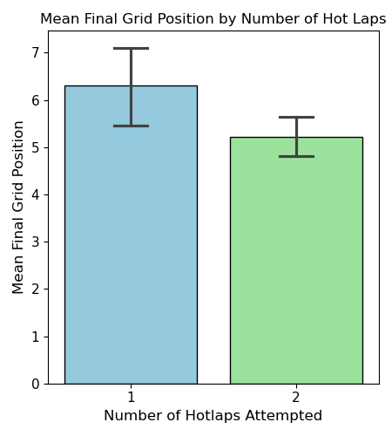
Insight: Attempt two Hot Laps When Possible
Insight Overview
> does number of hot laps affect final grid position? > two laps = more improvement chances, but higher risk > 79% of drivers attempt two laps, 20% attempt one lap > Fixed-Effects regression to control for session differences

Slide 5


Insight: Attempt two Hot Laps When Possible
Why two hot laps lead to higher grid position
> Assumptions mostly satisfied (Linearity, Normality, Independence) > Two Laps = 1.89 Places higher on average (p = 0.002) > True Gain between 0.73 and 3.05 places > Two Hot laps give a clear advantage for the grand prix

Slide 6
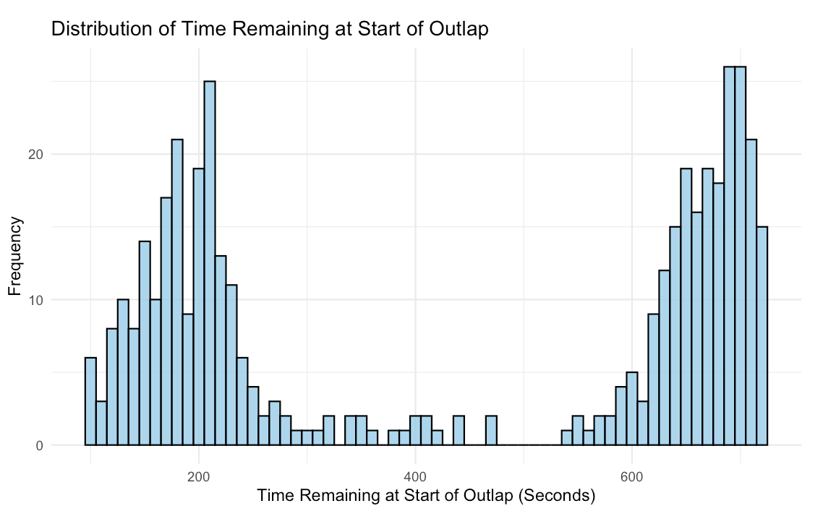
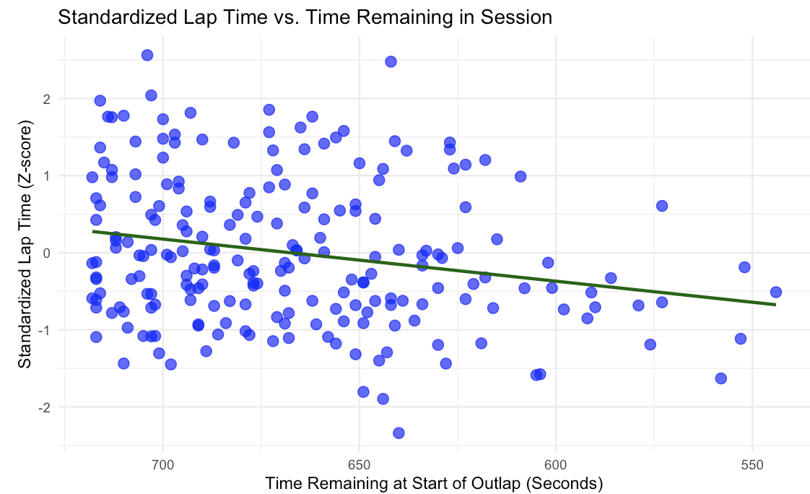
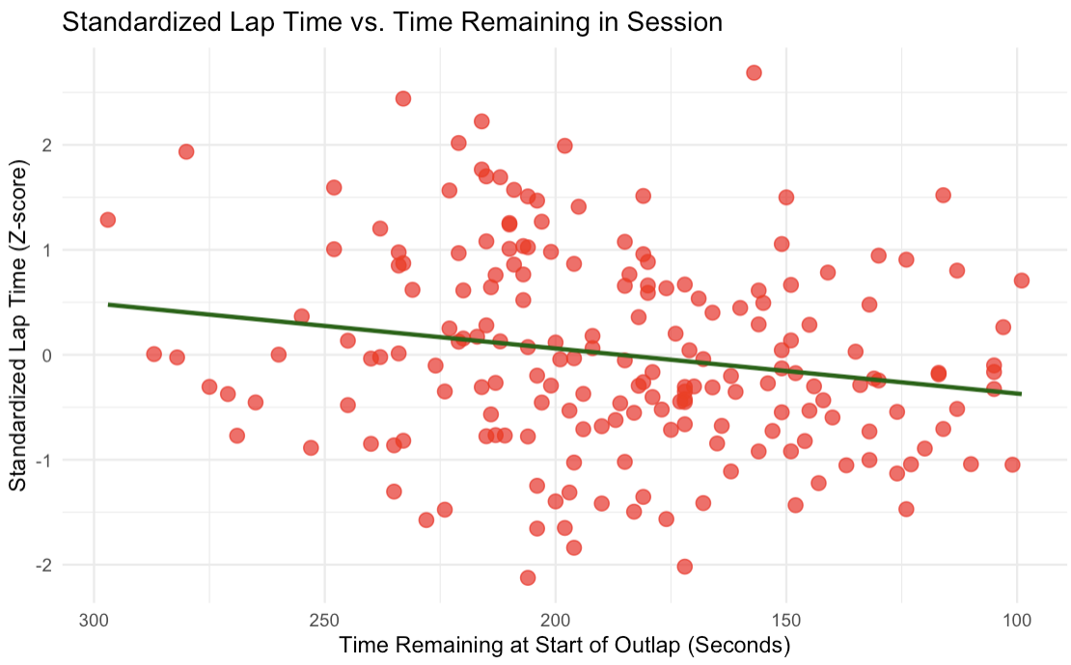
Insight: Starting OuTLAP LateR in Session Leads to Improved Lap Time
Data Exploration
> Drivers Typically Enter Track Twice, at beginning and end of Q3
> Data Subsetted into two groups
> Lap Times Standardized
Downward Trend
> starting Out laps later in session correlated with faster lap times For Both Subtests

Slide 7

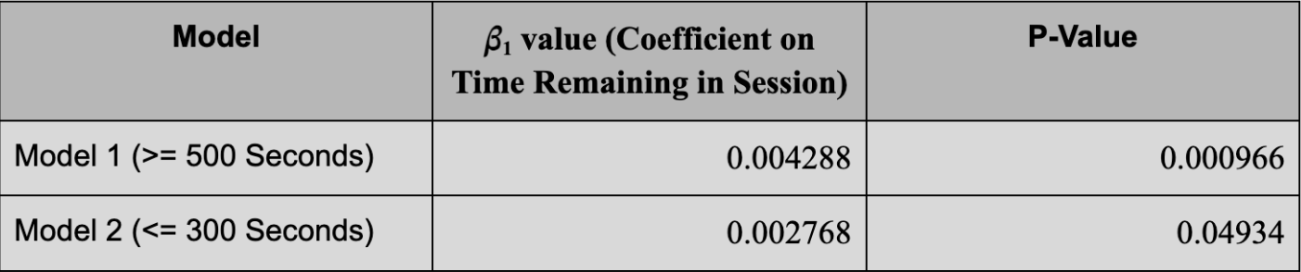
Insight: Starting OuTLAP LateR in Session Leads to Improved Lap Time
Fixed Effects Regression Model
> RAn Regression Of Standardized Lap Time on Time Remaining at start of outlap
> Fixed Effects for Teams
> Separate Model For Beginning and End of Session Subsets
Results
> Coefficients on Time Remaining in Session at Start of outlap statistically significant for both models
> Drivers should Enter track as late as possible while still attempting two hot laps

Slide 8
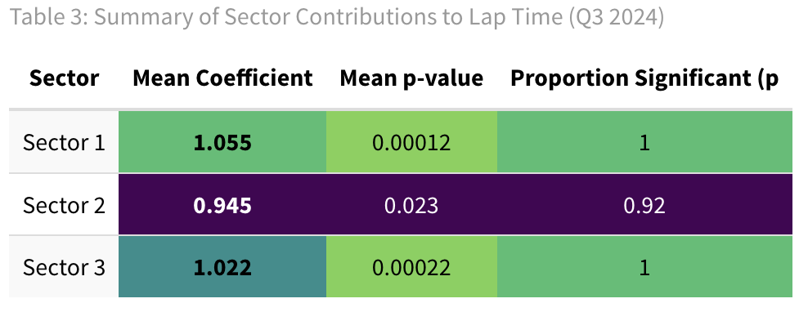
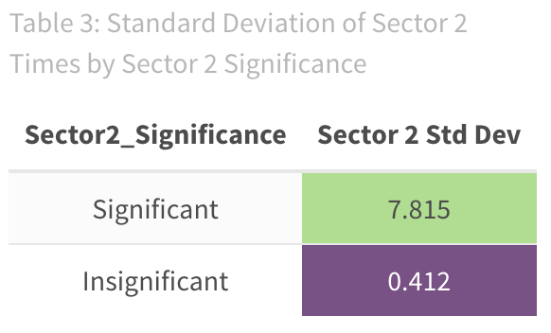
Insight: Sector 2’s Influence is Track-Dependent and Limited
Insight Overview
> Analyzed Q3 sector times across 2024 F1 races using regression models > Sector 2 was less predictive of lap time than Sectors 1 and 3 > Saudi Arabia and Spain races showed insignificant Sector 2 influence > Low variance in Sector 2 times explained the lack of impact

Slide 9
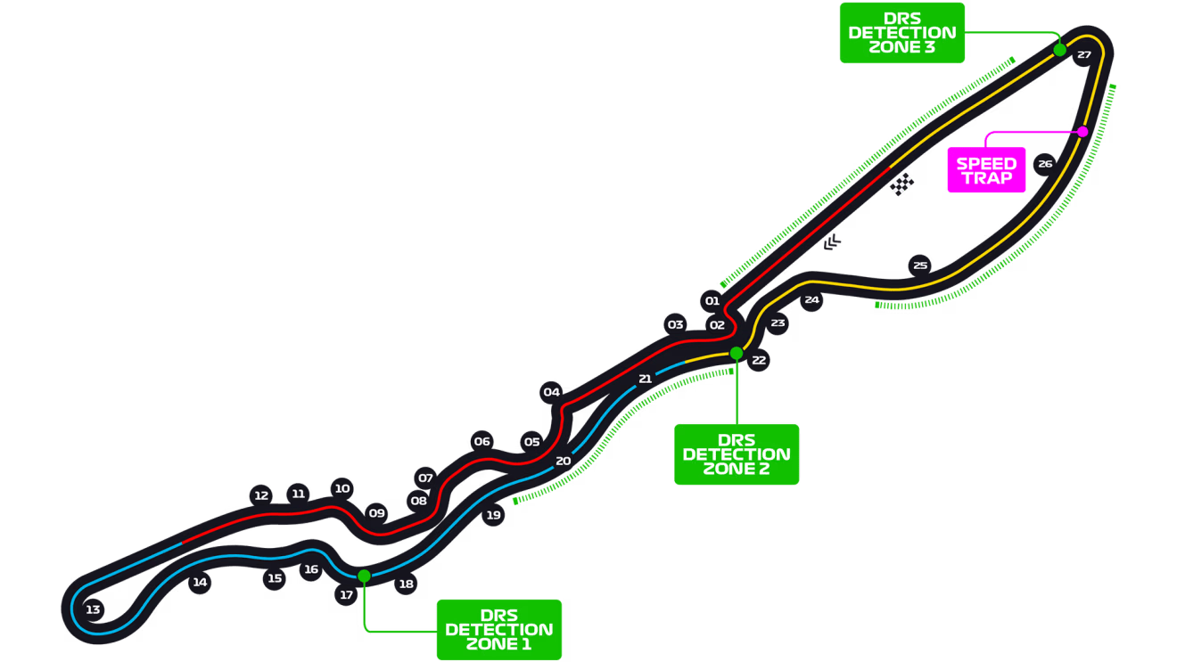
Insight: Sector 2’s Influence is Track-Dependent and Limited
Why sector 2 was less important
> Barcelona and Jeddah Sector 2s are high-speed, aero-dependent > Limited braking and line variation → similar driver performances > Car setup, not driver aggression, determined lap time > Strategy: Focus improvements on Sectors 1 and 3 for better qualifying gains

